Slide 1
Domain: DL
Technology: Python
Stock Price Prediction using Machine Learning

Slide 2
INDEX
Project Description
Problem Statement
Objective
Scope
Literature Survey
Significant
Proposed System
Architecture
Resource Requirements
Research Gap analysis
Implementation
Implementation
1. Data Description
2. EDA
3. Preprocessing steps
Model Implementation
1. Algorithm Definition
2. Working Flow
References

Slide 3
Project Description
This project aims to develop reliable models for predicting stock prices, focusing on banking sector stocks from the Nifty 50 index, including SBI, HDFC, Axis, ICICI, and IndusInd Bank. By analyzing five years of market data, the project compares traditional and advanced techniques such as Vanilla LSTM, Stacked LSTM, GRU, RNN. The objective is to forecast stock closing prices for the first half of 2024 and validate model accuracy by comparing predictions with actual data. The project seeks to create an optimal forecasting model that aids investors, analysts, and financial professionals in making informed decisions. This helps reduce risks and optimize investment strategies, demonstrating the potential of advanced data analysis in financial forecasting.

Slide 4
Problem Statement
The stock market is inherently volatile, making it challenging for investors and financial professionals to predict stock prices accurately. Traditional forecasting methods often fall short in capturing the complex patterns and behaviors of stock market data. This project aims to address this challenge by developing an optimal and reliable forecasting model using both traditional and advanced machine learning techniques (Vanilla LSTM, Stacked LSTM, GRU, RNN) to predict the stock prices of five prominent banks in the Nifty 50 index: SBI, HDFC, Axis, ICICI, and IndusInd Bank. The goal is to enhance decision-making in the financial sector by providing precise stock price predictions, reducing investment risks, and contributing to the advancement of financial forecasting methodologies.

Slide 5
Objective of the Project
This study investigates evaluating deep learning techniques to enhance stock price forecasting accuracy.
• Data Collection and Analysis: Historical stock price data for five major Indian banks SBI, HDFC, AXIS, ICICI, and IndusInd Bank—will be gathered over the past five years using the Yahoo Finance API. Exploratory Data Analysis (EDA) will identify trends and patterns.
• Feature Engineering: The study will implement feature engineering to improve data quality, preparing it for machine learning models by transforming and selecting relevant features.
• Model Development: Various models, including Vanilla LSTM, Stacked LSTM, GRU, RNN, will be built and trained to predict future stock prices.
• Model Evaluation: Trained models will be tested with 2024 data, using metrics like MSE, MAE, RMSE, and R² Score to assess performance.

Slide 6
Scope
Development of Advanced Forecasting Models: The project will explore and compare traditional and advanced techniques, including Vanilla LSTM, Stacked LSTM, GRU, RNN, , and , to predict stock prices with a focus on five major banks from the Nifty 50 index.
Real-World Application in Financial Markets: By providing accurate stock price predictions for SBI, HDFC, Axis, ICICI, and IndusInd Bank, the project aims to assist investors and financial professionals in making informed investment decisions, minimizing risks, and optimizing strategies.
Validation and Contribution to Financial Forecasting: The project will validate model predictions against actual market data for the first half of 2024, contributing to the broader field of financial forecasting by demonstrating the effectiveness of advanced data analysis in predicting stock market behavior.

Slide 7
LITERATURE SURVEY
Author | Year | Title | Outcomes
Diaa Salama Abd Elminaam, et al. | 2024 | StockBiLSTM: Utilizing an Efficient Deep Learning Approach for Forecasting Stock Market Time Series Data | Introduced StockBiLSTM for efficient stock market forecasting, improving prediction accuracy.
Kumar, R., Kumar, P., Kumar Y. | 2021 | Analysis of Financial Time Series Forecasting using Deep Learning Model | Demonstrated the use of deep learning models to analyze and forecast financial time series data.

Slide 8
LITERATURE SURVEY
Author | Year | Title | Outcomes
Zhang, K., Zhang G., Dong, J. | 2019 | Stock Market Prediction Based on Generative Adversarial Network | effectively models stock market behaviors and enhances prediction accuracy.
Fischer, T., & Krauss, C. | 2018 | Deep Learning with Long Short-Term Memory Networks for Financial Market Predictions | LSTM networks significantly improve financial market predictions compared to traditional methods.

Slide 9
Significant
Improved Predictive Accuracy: The project leverages a range of traditional and advanced models to identify the best method for forecasting banking stock prices, enhancing prediction reliability.
Support for Informed Decision-Making: Accurate stock price predictions help investors and financial professionals reduce risks and optimize investment strategies.
Understanding Market Behavior: Analyzing historical data uncovers trends in stock movements, aiding in better anticipation of market shifts.
Advancing Financial Forecasting: The project highlights the potential of advanced AI and machine learning models in improving stock market predictions.

Slide 10
Proposed System:
The proposed system aims to develop a robust stock price prediction model by utilizing a variety of machine learning techniques, including Vanilla LSTM, Stacked LSTM, GRU, RNN and It focuses on forecasting the stock prices of five prominent banking institutions from the Nifty 50 index—SBI, HDFC, Axis, ICICI, and IndusInd Bank—using five years of historical market data. The system will generate predictions for the first half of 2024 and compare them with actual stock prices to validate model accuracy. The ultimate goal is to create a reliable model that supports better financial decision-making and investment strategies.

Slide 11
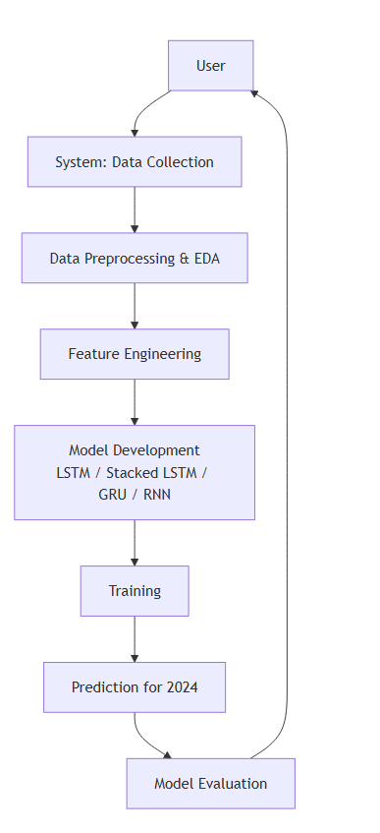
Architecture

Slide 12
Resource Requirements
01
Hardware
(Processor: I5/Intel Processor, RAM: 8GB (min), Hard Disk: 128 GB, Key Board: Standard Windows Keyboard, Mouse: Two or Three Button Mouse)
Resources
02
Software
(Operating System: Windows 10, Programming Language: Python 3.10.8, IDE: Colab)
03
Packages/Libraries
(Pandas, Numpy, Scikit-learn, Yahoo Finance(yfinance), tensorflow, keras)

Slide 13
UML DIAGRAMS
UML stands for Unified Modelling Language. UML is a standardized general-purpose modelling language in the field of object-oriented software engineering. The standard is managed, and was created by, the Object Management Group.
The goal is for UML to become a common language for creating models of object-oriented computer software. In its current form UML is comprised of two major components: a Meta-model and a notation. In the future, some form of method or process may also be added to; or associated with, UML.
The Unified Modelling Language is a standard language for specifying, Visualization, Constructing and documenting the artefacts of software system, as well as for business modelling and other non-software systems. The UML represents a collection of best engineering practices that have proven successful in the modelling of large and complex systems.
The UML is a very important part of developing objects-oriented software and the software development process. The UML uses mostly graphical notations to express the design of software projects.

Slide 14
GOALS:
The Primary goals in the design of the UML are as follows:
Provide users a ready-to-use, expressive visual modelling Language so that they can develop and exchange meaningful models.
Provide extendibility and specialization mechanisms to extend the core concepts.
Be independent of particular programming languages and development process.
Provide a formal basis for understanding the modelling language.
Encourage the growth of OO tools market.
Support higher level development concepts such as collaborations, frameworks, patterns and components.
Integrate best practices.

Slide 15
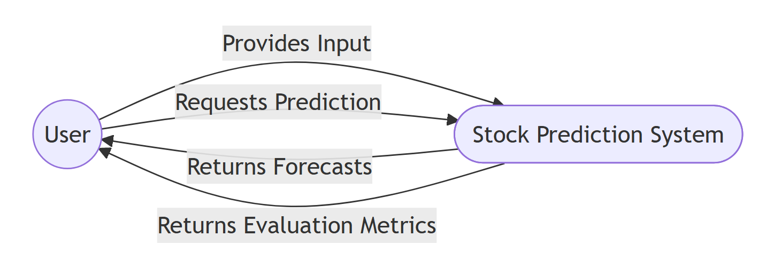
USE CASE DIAGRAM
A use case diagram in the Unified Modeling Language (UML) is a type of behavioral diagram defined by and created from a Use-case analysis.
Its purpose is to present a graphical overview of the functionality provided by a system in terms of actors, their goals (represented as use cases), and any dependencies between those use cases.
The main purpose of a use case diagram is to show what system functions are performed for which actor. Roles of the actors in the system can be depicted.

Slide 16
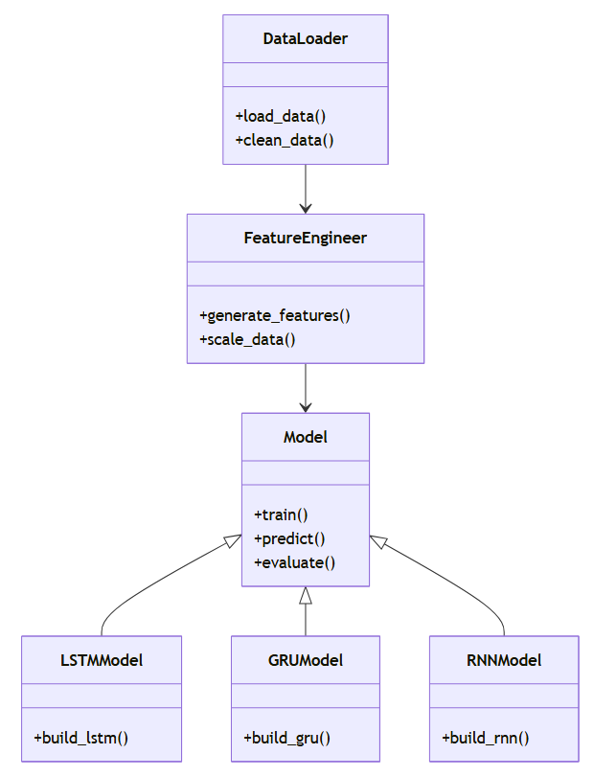
CLASS DIAGRAM
In software engineering, a class diagram in the Unified Modeling Language (UML) is a type of static structure diagram that describes the structure of a system by showing the system's classes, their attributes, operations (or methods), and the relationships among the classes. It explains which class contains information

Slide 17
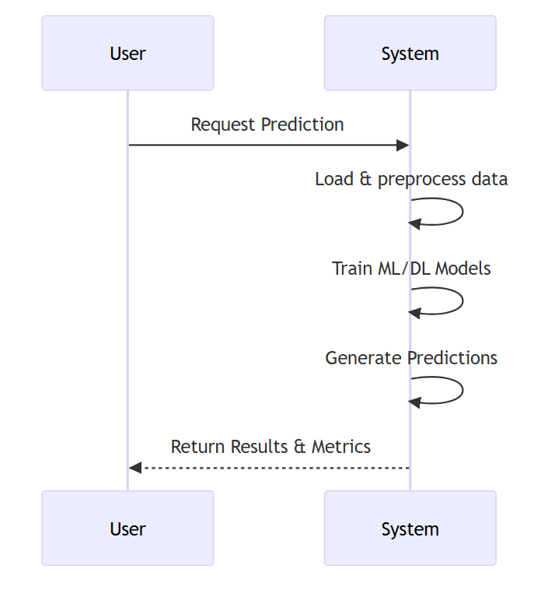
SEQUENCE DIAGRAM
A sequence diagram in Unified Modeling Language (UML) is a kind of interaction diagram that shows how processes operate with one another and in what order.

Slide 18
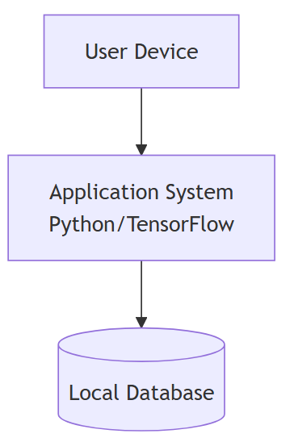
DEPLOYMENT DIAGRAM
Deployment diagram represents the deployment view of a system. It is related to the component diagram. Because the components are deployed using the deployment diagrams. A deployment diagram consists of nodes. Nodes are nothing but physical hardware’s used to deploy the application.

Slide 19
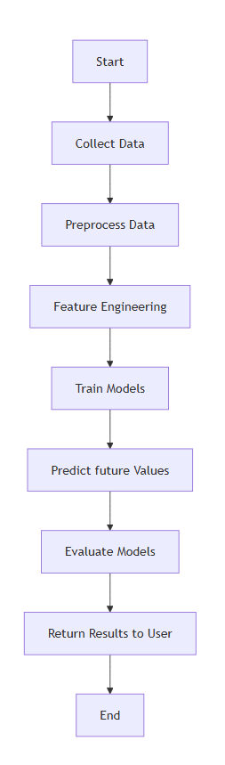
ACTIVITY DIAGRAM:
Activity diagrams are graphical representations of workflows of stepwise activities and actions with support for choice, iteration and concurrency. In the Unified Modelling Language, activity diagrams can be used to describe the business and operational step-by-step workflows of components in a system. An activity diagram shows the overall flow of control.

Slide 20
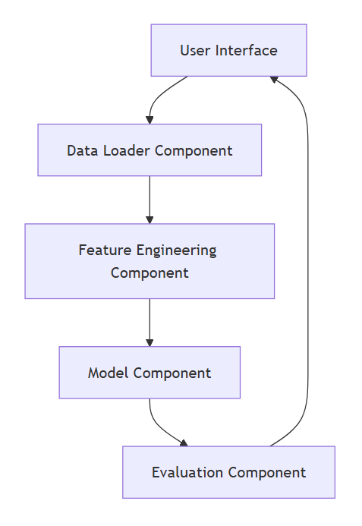
COMPONENT DIAGRAM:
A component diagram, also known as a UML component diagram, describes the orization and wiring of the physical components in a system. Component diagrams are often drawn to help model implementation details and double-check that every aspect of the system's required function is covered by planned development.

Slide 21
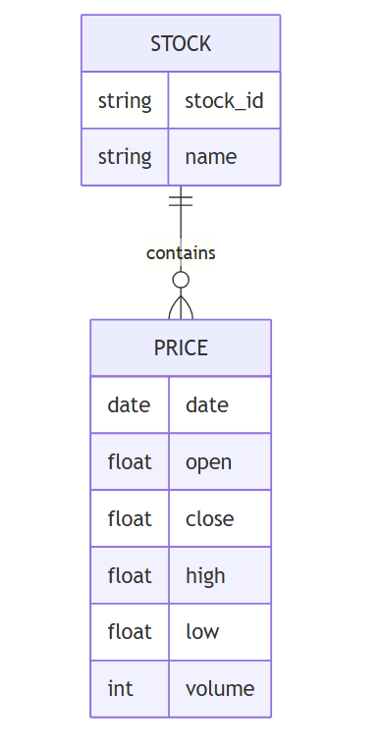
ER DIAGRAM:
An Entity–relationship model (ER model) describes the structure of a database with the help of a diagram, which is known as Entity Relationship Diagram (ER Diagram). An ER model is a design or blueprint of a database that can later be implemented as a database. The main components of E-R model are: entity set and relationship set.
An ER diagram shows the relationship among entity sets. An entity set is a group of similar entities and these entities can have attributes. In terms of DBMS, an entity is a table or attribute of a table in database, so by showing relationship among tables and their attributes, ER diagram shows the complete logical structure of a database. Let’s have a look at a simple ER diagram to understand this concept.

Slide 22
DFD DIAGRAM:
A Data Flow Diagram (DFD) is a traditional way to visualize the information flows within a system. A neat and clear DFD can depict a good amount of the system requirements graphically. It can be manual, automated, or a combination of both. It shows how information enters and leaves the system, what changes the information and where information is stored. The purpose of a DFD is to show the scope and boundaries of a system as a whole. It may be used as a communications tool between a systems analyst and any person who plays a part in the system that acts as the starting point for redesigning a system.

Slide 23
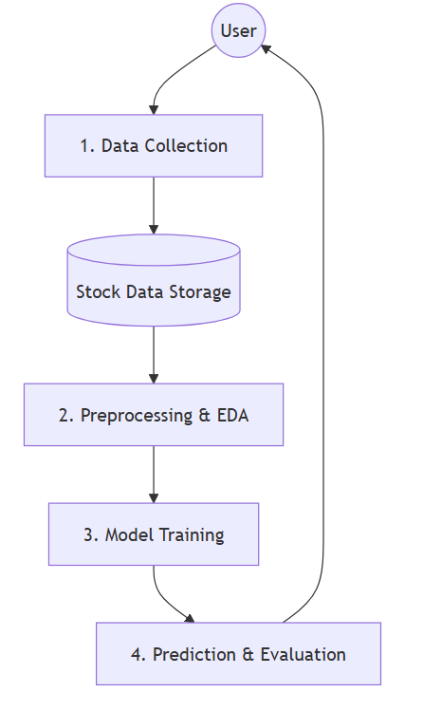
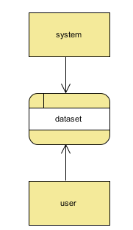
Context Diagram:
DFD Level-1 Diagram:

Slide 24
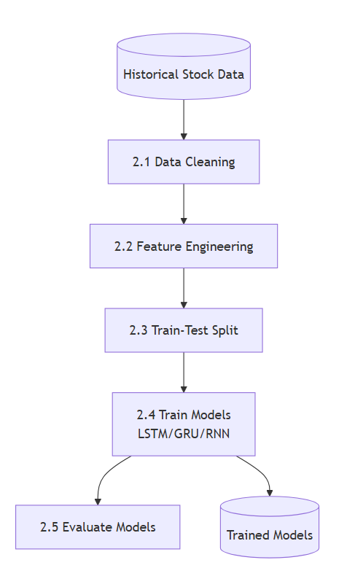
DFD Level-2 Diagram:

Slide 25
Research Gap analysis
Limited Use of Advanced Models: While traditional models like RNNs are often used in stock price prediction, the application of more advanced models such as s and s remains underexplored in this domain, especially for banking stocks.
Sector-Specific Forecasting: Most existing studies focus on broad stock indices or general sectors. There is a gap in focused research on predicting stock prices for the banking sector, particularly in the context of Indian banks listed under Nifty 50.
Short-Term Prediction Accuracy: Many models struggle with short-term prediction accuracy due to the volatile nature of the stock market, indicating the need for more refined techniques and comparative studies to enhance performance.

Slide 26
Implementation
Data Analysis
Model Implementation
01
Data Description
03
Algorithm Definition
02
Working Process
04
Preprocessing steps
05
Results from Algorithm

Slide 27
Data Description
Stock Data Source: The dataset includes historical stock data from five major Indian banks (SBI, HDFC, Axis, ICICI, and IndusInd) listed on NSE, collected via Yahoo Finance API from January 1, 2019, to June 30, 2024.
Focus on Closing Prices: The dataset centers on the closing price of each stock, an essential indicator used in financial performance measurement, technical analysis, and stock price prediction.
Chronological Analysis: Each entry is timestamped with the trading date, allowing for the examination of trends, patterns, and stock performance over time.
Predictive Modeling Input: The dataset is designed for time-series forecasting and machine learning analysis, providing a streamlined, focused approach for stock price prediction.

Slide 28
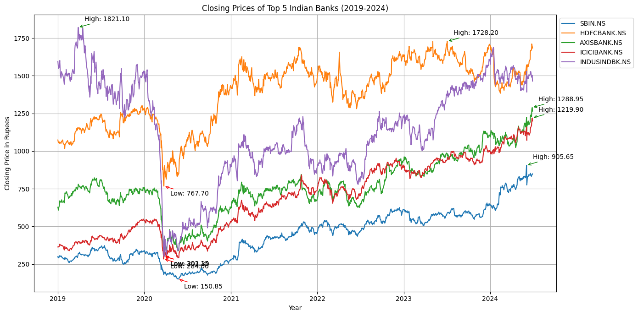
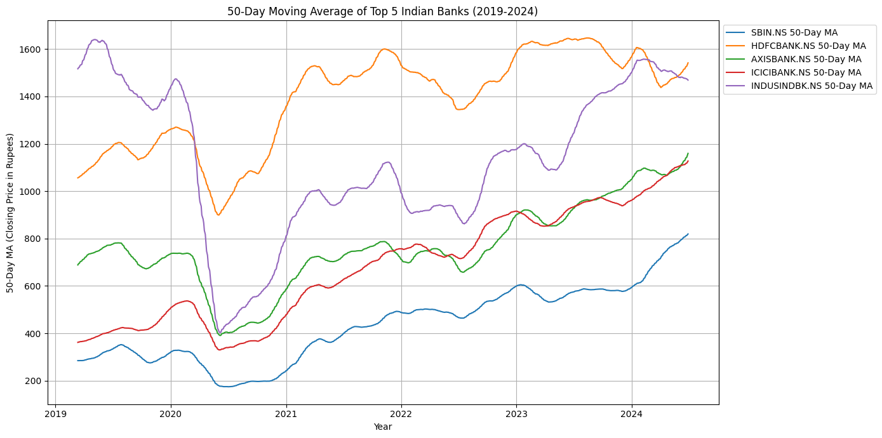
EDA
The graph shows the closing prices of top 5 Indian banks from 2019 to 2024, highlighting a sharp decline in early 2020 due to the COVID-19 pandemic, followed by a recovery trend. ICICI and IndusInd Bank display the most volatility and growth, while HDFC Bank shows a steady upward trend, with stock prices stabilizing by 2024.
The graph shows the 50-day moving averages of SBI, HDFC Bank, Axis Bank, ICICI Bank, and IndusInd Bank from 2019 to 2024. After a dip in early 2020 due to COVID-19, all banks show recovery, with ICICI Bank leading in performance, IndusInd Bank displaying volatility, and HDFC Bank maintaining steady growth. By 2024, all banks exhibit stable upward trends, reflecting sector growth.

Slide 29
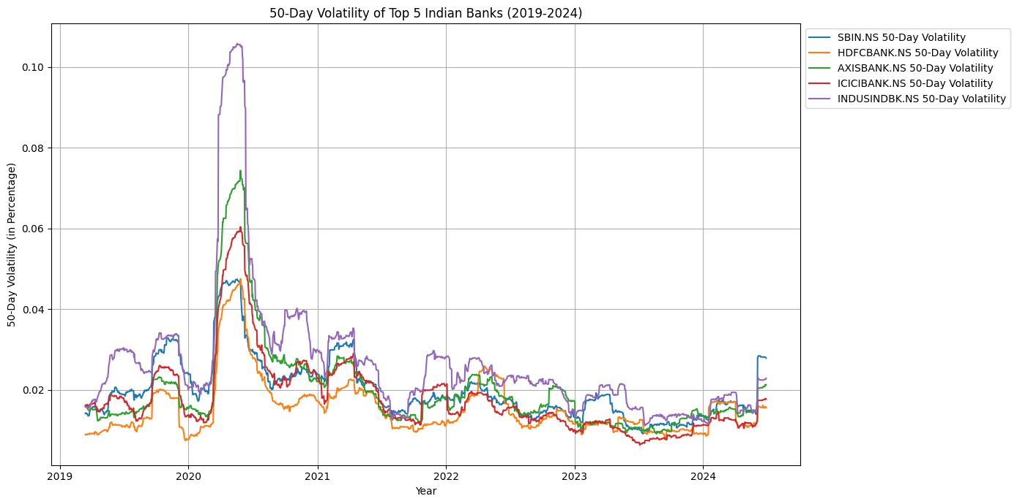
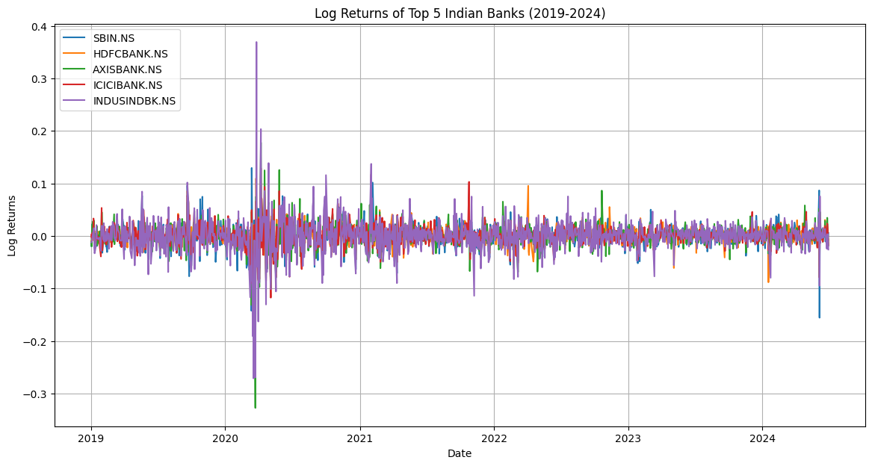
EDA
The graph shows the 50-day volatility of SBI, HDFC, Axis, ICICI, and IndusInd Bank from 2019 to 2024. A spike in early 2020 due to COVID-19 was followed by a steady decrease, stabilizing by mid-2021. A slight uptick in volatility is seen toward the end, particularly in SBI.
The graph shows the log returns of SBI, HDFC Bank, Axis Bank, ICICI Bank, and IndusInd Bank from 2019 to 2024, highlighting significant volatility in early 2020 due to COVID-19, especially for IndusInd Bank. Post-2020, log returns stabilize, indicating more consistent performance across all banks.

Slide 30
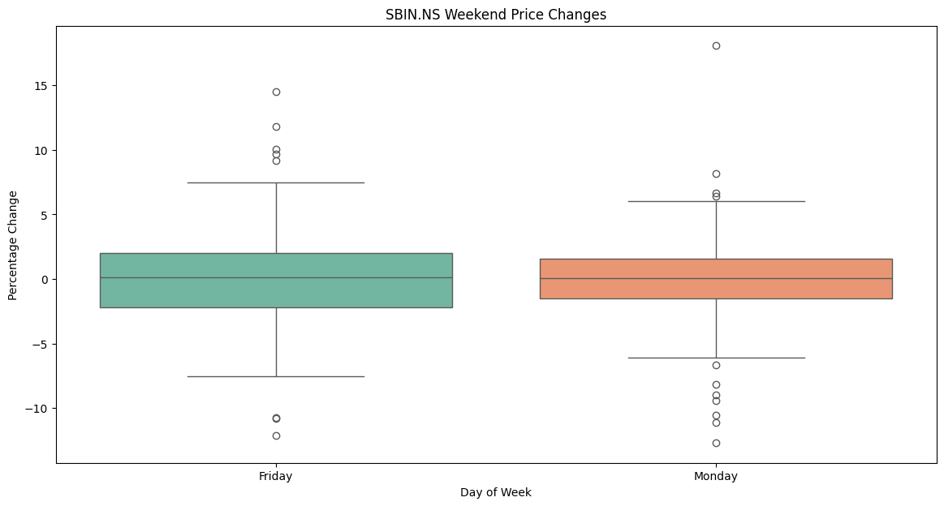
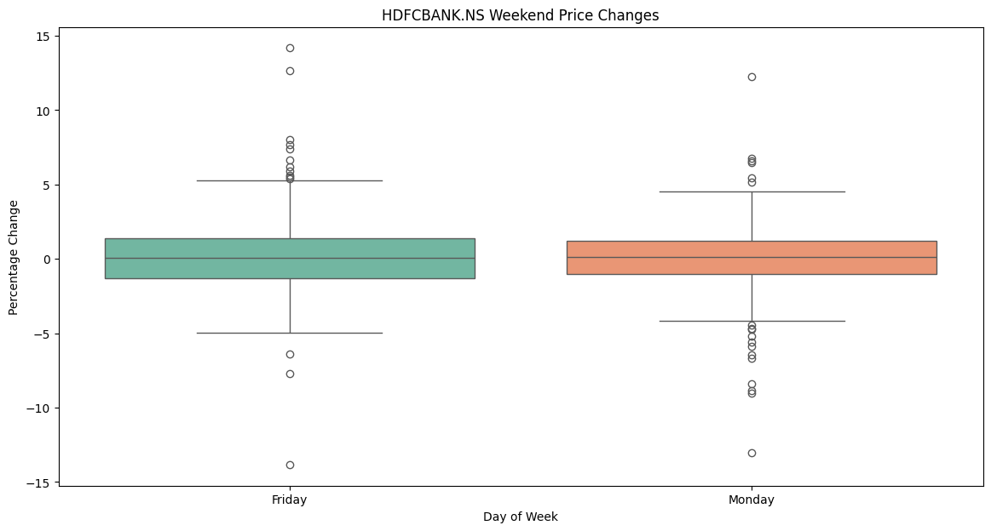
EDA
The box plot compares the percentage price changes of SBIN.NS on Fridays and Mondays. Fridays show generally positive price changes with fewer outliers, indicating stability, while Mondays exhibit greater variability and extreme outliers, suggesting unpredictable movements after the weekend.
The box plot compares the percentage price changes of HDFCBANK.NS on Fridays and Mondays, illustrating the weekend effect. Fridays show generally positive price changes with some outliers, while Mondays exhibit greater volatility and more extreme outliers. Both days have a positive median, but Mondays are more unpredictable, likely due to weekend market reactions..

Slide 31
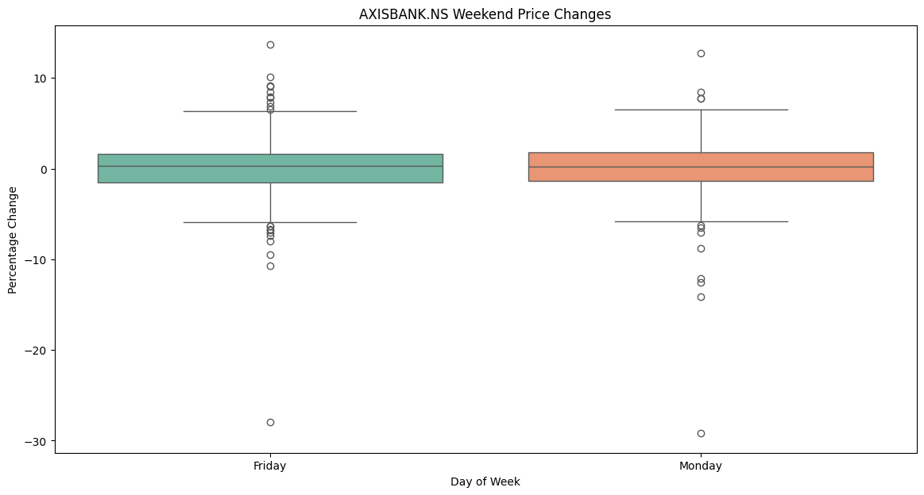
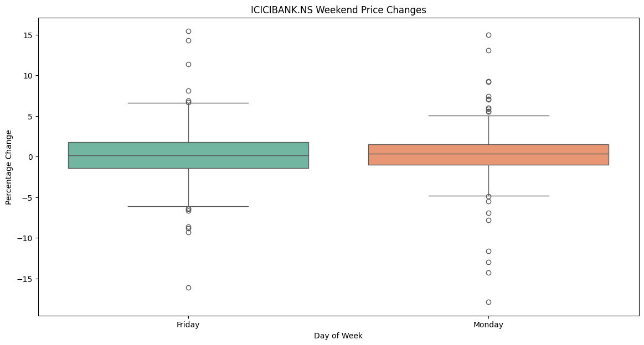
EDA
The box plot reveals that AXISBANK.NS experiences greater volatility and more extreme price changes, especially negative, on Mondays compared to Fridays. Fridays show relatively more stability, with fewer extreme movements.
The box plot shows that ICICIBANK.NS experiences greater volatility and more extreme positive price changes on Mondays compared to Fridays. Fridays exhibit more stable price movements with fewer extremes, indicating lower volatility before the weekend.

Slide 32
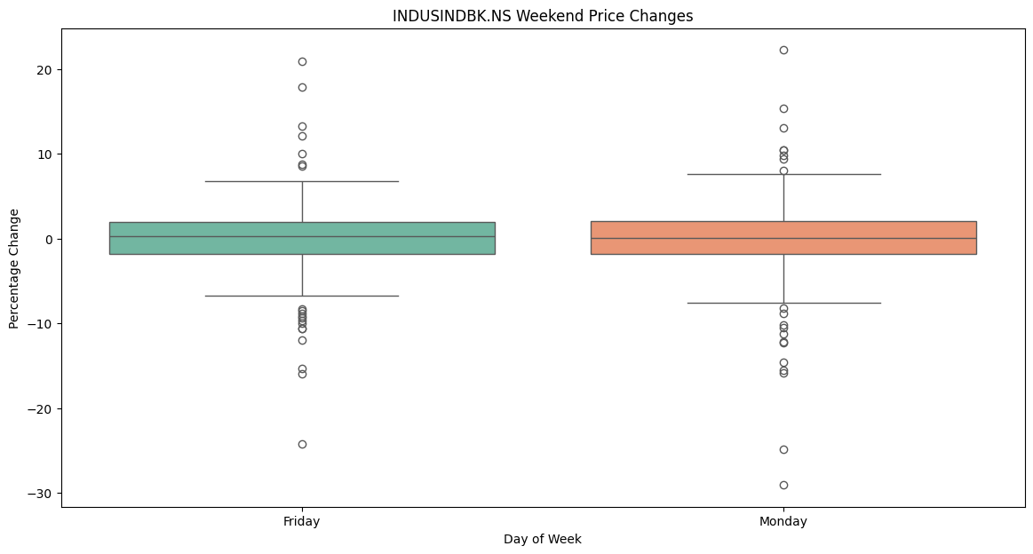
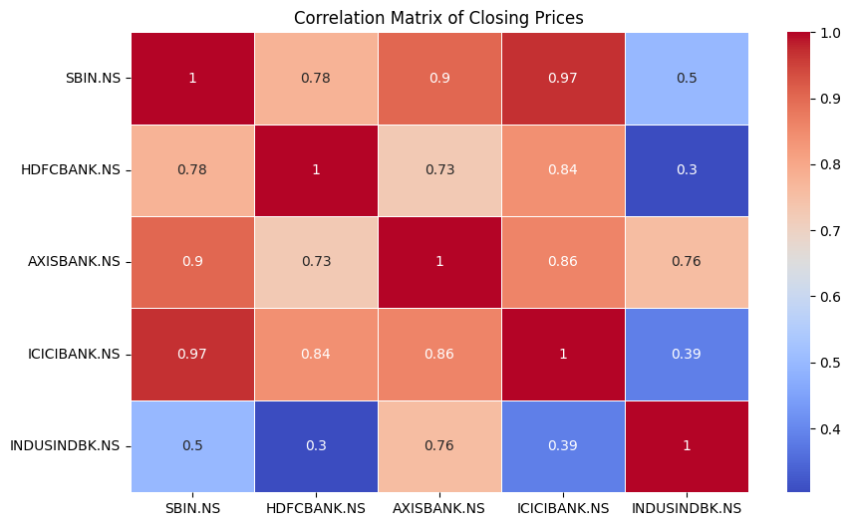
EDA
The box plot reveals that INDUSINDBK.NS experiences greater volatility and more extreme positive price changes on Mondays compared to Fridays. Fridays show more stable price movements, indicating a calmer trading environment before the weekend.
The heatmap shows strong positive correlations between SBIN.NS and ICICIBANK.NS (0.97), and SBIN.NS and AXISBANK.NS (0.9), indicating similar price movements. INDUSINDBK.NS has weaker correlations with other banks, particularly with HDFCBANK.NS (0.3) and ICICIBANK.NS (0.39), reflecting less synchronized price movements.

Slide 33
Pre-processing steps
Data Normalization: Min-Max scaling is used to bring features like stock prices and trading volumes into a uniform range, typically between 0 and 1. This prevents larger numerical features from dominating the model and aids in faster convergence during model training, especially for gradient-based algorithms.
Data Splitting: In time series forecasting, data is split sequentially into training and testing sets, preserving chronological order. This avoids data leakage and ensures that the model is evaluated on the most recent data, simulating real-world forecasting scenarios.
Rolling Window Approach: This method uses a fixed window of historical data to continuously update the model, allowing it to predict the next time step. The window shifts forward after each prediction, helping the model adapt to recent market trends for improved stock price forecasting.
Data Cleaning: This process involves handling missing values through techniques like forward filling and interpolation, managing outliers using methods like Z-score analysis or interquartile range, and performing consistency checks to ensure data accuracy and reliability for better model performance.

Slide 34
ALGORITHMS
Vanilla LSTM
Vanilla LSTM Model Overview: The Vanilla LSTM model is used to predict stock prices for five major Indian banks listed in the Nifty50 index. It is designed to capture long-term patterns in time series data and serves as a benchmark for comparing more advanced models like Stacked LSTM and GRU.
Model Architecture: The architecture includes a bidirectional LSTM layer, followed by dropout layers to prevent overfitting, a second unidirectional LSTM layer, and a Dense layer for merging outputs. The final output is a single-unit Dense layer that predicts the stock price.
Compilation and Optimization: The model uses the Adam optimizer with a learning rate between 1e-4 and 1e-2 and the Mean Squared Error (MSE) loss function, making it suitable for stock price prediction tasks. Hyperparameters such as LSTM units, dropout rates, and learning rates are fine-tuned to optimize performance.
Model Training and Evaluation: The model is trained on historical stock data (closing prices and trading volumes) from five banks, with the data split into training and validation sets. The results from the Vanilla LSTM serve as a baseline for evaluating more complex models like Stacked LSTM and GRU.

Slide 35
ALGORITHMS
Stacked LSTM
Stacked LSTM Model Overview: The Stacked LSTM model enhances the Vanilla LSTM by incorporating multiple LSTM layers, making it more capable of capturing complex temporal relationships in stock price data. It is used to predict the prices of five major Indian banks in the Nifty50 index.
Model Architecture: The architecture includes 2 to 4 LSTM layers with units ranging from 50 to 200. Dropout layers are applied after each LSTM layer to prevent overfitting, and a Dense layer processes the output before predicting the stock price.
Compilation and Optimization: The model is compiled using the Adam optimizer with a learning rate between 1e-4 and 1e-2, and Mean Squared Error (MSE) is used as the loss function to penalize prediction errors.
Training and Evaluation: The model is trained on normalized historical stock price data, with the dataset split into training and validation sets. The Stacked LSTM's performance is compared to Vanilla LSTM and GRU models, with expectations of better handling complex financial time series patterns.

Slide 36
ALGORITHMS
RNN
RNN Layers: The model uses 1–3 RNN layers with 50–200 units per layer, capturing temporal dependencies. The return_sequences parameter is enabled for all layers except the last, which outputs the final state.
Dropout and Dense Layers: Dropout layers (0.1–0.5) reduce overfitting after each RNN layer, while Dense layers (10–50 units) combine features and output the final stock price prediction.
Compilation: The model uses the Adam optimizer (learning rate 1e-4 to 1e-2) and MSE as the loss function to minimize prediction errors in stock prices.
Training and Tuning: Hyperparameter optimization adjusts layers, units, dropout rates, and learning rates. The model’s performance is compared with GRU and LSTM, prioritizing faster training for real-time forecasting.

Slide 37
ALGORITHMS
GRU
GRU Layers: The model uses 2–4 GRU layers with 50–200 units per layer, capturing temporal dependencies in stock data, with return sequences enabled for all but the final layer.
Dropout and Dense Layers: Dropout (0.1–0.5) prevents overfitting after each GRU layer, followed by Dense layers to reduce dimensions and output the predicted stock price.
Compilation: The model is compiled using the Adam optimizer (learning rate 1e-4 to 1e-2) with MSE loss for accurate regression predictions.
Hyperparameter Tuning: Systematic tuning of layers, units, dropout rates, and learning rates is done, comparing GRU performance with Vanilla and Stacked LSTM models.

Slide 38
ALGORITHMS
Encoder: The uses two Bidirectional LSTM layers with 64–256 units to process input sequences, followed by dropout layers for regularization, and compresses the input into a lower-dimensional latent space (20–100 units).
Decoder: The latent vector is repeated for each time step, and a LSTM layer reconstructs the input sequence, followed by a Time Distributed Dense layer for output generation.
Compilation: The model uses the Adam optimizer (learning rate 1e-4 to 1e-2) with MSE as the loss function to minimize prediction errors.
Training and Tuning: Hyperparameter tuning optimizes LSTM units, dropout rates, latent dimension size, and learning rates. The model's performance is compared with LSTM and GRU models for stock price prediction.

Slide 39
ALGORITHMS
Generator: The ’s generator uses LSTM layers (64–256 units) to transform random noise into synthetic stock price sequences, mimicking real stock data.
Discriminator: LSTM layers in the discriminator evaluate the authenticity of generated sequences, classifying them as real or fake, followed by a Dense layer that provides a probability score.
Compilation: The model uses the Adam optimizer (learning rate 1e-4 to 1e-2). The generator and discriminator have separate loss functions optimized for effective training.
Training and Tuning: Hyperparameters (LSTM units, dropout rates, learning rates) are tuned via Random Search. The model's performance is compared with LSTM and GRU models to enhance prediction accuracy.

Slide 40
Working Flow of Stacked LSTM
Input Sequence Processing: In a Stacked LSTM, sequential input data (e.g., stock prices) is fed into multiple layers of LSTM cells. The output from one LSTM layer serves as the input for the next, enabling deeper learning of temporal patterns.
Multiple LSTM Layers: Each LSTM layer processes the sequence, capturing more complex temporal dependencies at different levels. The return_sequences parameter is typically set to True for all layers except the final one to pass the full sequence between layers.
Final LSTM Layer: The last LSTM layer outputs either the final hidden state or the entire sequence, depending on the configuration, which represents the learned features of the input data.
Dense Layer for Prediction: The output of the final LSTM layer is fed into a Dense layer to generate the final prediction, such as the next stock price in the sequence. This stacking increases model capacity for learning more intricate patterns.

Slide 41
Working Flow of RNN
Input Sequence Processing: The RNN model processes sequential input data (e.g., stock prices) one time step at a time, passing the current input and previous hidden state to the RNN cell, which captures short-term temporal dependencies.
RNN Cell Mechanism: At each time step, the RNN cell updates its hidden state using the current input and the previous hidden state. The RNN lacks the advanced gating mechanisms of LSTM, making it more prone to vanishing gradients when processing long sequences.
Hidden State Propagation: The hidden state is propagated through each time step of the sequence, learning dependencies based on the input data. However, RNNs can struggle to capture long-term dependencies compared to LSTM or GRU models.
Dense Layer for Output: After the final time step, the hidden state is passed to a Dense layer, which produces the final prediction (e.g., stock price prediction for the next time step). The simplicity of RNNs makes them faster but less effective for long sequences.

Slide 42
References
Fischer, T., & Krauss, C. (2018). Deep Learning with Long Short-Term Memory Networks for Financial Market Predictions. European Journal of Operational Research, 270(2), 654-664. doi:10.1016/j.ejor.2017.11.054
Hochreiter, S., & Schmidhuber, J. (1997). Long Short-Term Memory. Neural Computation, 9(8), 1735-1780. doi:10.1162/neco.1997.9.8.1735
Zhang, K., Zhang G., Dong, J., (2019). Stock Market Prediction Based on Generative Adversarial Network. Procedia Computer Science, 147, 400-406. doi:10.1016/j.procs.2019.01.256
Kumar, R., Kumar, P., Kumar Y., (2021). Analysis of Financial Time Series Forecasting using Deep Learning Model. 2021 11th International Conference on Cloud Computing, Data Science & Engineering. doi:10.1109/Confluence51648.2021.9377158
Diaa Salama Abd Elminaam, Asmaa M M. El-Tanany, Mohamed Abd El Fattah and Mustafa Abdul Salam, (2024). StockBiLSTM: Utilizing an Efficient Deep Learning Approach for Forecasting Stock Market Time Series Data. International Journal of Advanced Computer Science and Applications (IJACSA), 15(4), doi:10.14569/IJACSA.2024.0150446

Slide 43
THANK YOU

